Slide 1
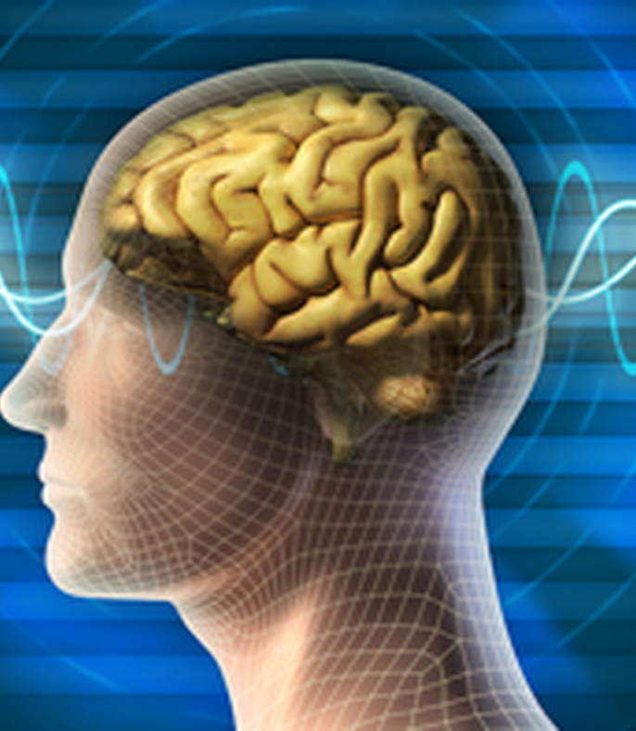

PRESENTATION
Understanding
Mental Health &
Mental Illness
Apostolic Christian Church (Nazarean) of West Akron
SPEAKERS
Erik Taba Ed Jahn
226-260-2557 519-818-4137
Erik.taba@gmail.com ed@jahneng.com
*

Slide 2

Website:acncounseling.org
Bear ye one another's burdens, and so fulfil the law of Christ.
(Galatians 6:2)
*

Slide 3
Understanding Mental Health & Mental Illness
Why should I care?
    You will face this, if you haven’t already
    Gain understanding
    Help fight the stigma
    Help yourself and others
    Glorify God
*

Slide 4
“Fear thou not; for I am with thee: be not dismayed; for I am thy God: I will strengthen thee; yea, I will help thee; yea, I will uphold thee with the right hand of my righteousness.”
(Isaiah 41:10)
*

Slide 5
What does a person look like who has a
“Mental Illness”?
*

Slide 6

*

Slide 7

*

Slide 8
Understanding Mental Health & Mental Illness
Thinking – how we understand, interpret, and respond to situations
Emotions – what we feel and how we manage those feelings
Functioning – how we cope, make decisions, relate to others, and handle daily life
*

Slide 9






What Mental Health Often Looks Like
Thinking • Emotions • Functioning
Thinking is generally clear and grounded
Emotions generally fit the situation and can be managed
Able to cope with ordinary stress and setbacks
Can make sound daily decisions
Able to handle daily responsibilities
Can relate to others and contribute to family, church, and community
*

Slide 10

What Mental Illness May Look Like
Thinking • Emotions • Functioning
Persistent problems in thinking, emotions, or functioning
Thinking may become confused, fearful, hopeless, or distorted
Feelings may be intense, persistent, or hard to manage
Daily responsibilities become harder to handle
Relationships, work, school, and spiritual walk may be affected
May need support, counselling, medical care, or other treatment
*

Slide 11
Brief History of Mental Illness
Ancient–1700s
• Often explained as spiritual or supernatural
• Care ranged from family support to confinement and harsh treatments
1800s–Early 1900s
• More humane care and psychiatric hospitals developed
• Talk therapy and experimental treatments began
1950s–Current
• Medications expanded; care shifted into the community (homelessness/incarceration challenges)
• Today: therapy, medication, social support and research
*

Slide 12
Stigma
*

Slide 13

Before the fall….
Genesis 2 [7] And the LORD God formed man of the dust of the ground, and breathed into his nostrils the breath of life; and man became a living soul.
*

Slide 14

After the fall….
Genesis 3 [8] …and Adam and his wife hid themselves from the presence of the LORD God amongst the trees of the garden.
*

Slide 15
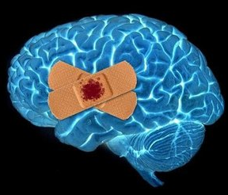

After the fall….
?
    Mental illness is not something invented by secular psychiatrists
*

Slide 16
Why Mental Illness Is Sometimes Misunderstood or Stigmatized
• Fear of what we do not understand
• History and media reinforce negative stereotypes
• Mistaken for laziness, weakness, or poor character
• Emotional struggles mistaken for weak faith
• Mental illness confused with sin or demonic possession
• Belief that seeking professional counselling or medical care replaces faith, scripture, or prayer
*

Slide 17
Clinical Depression is a serious illness, Just like diabetes or heart disease.
“Expecting positive thinking to cure clinical depression is like expecting a person with diabetes to lower his blood sugar levels by thinking happy thoughts.”
*

Slide 18
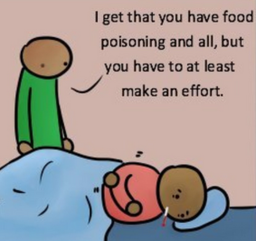
*

Slide 19
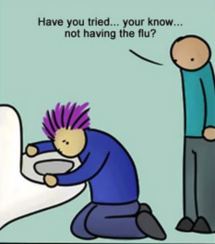
*

Slide 20
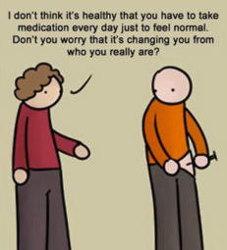
*

Slide 21
Common Warning Signs of Mental Health Struggles
Changes in Thinking & Emotions
• Persistent sadness or hopelessness
• Excessive fears, worries, or anxiety
• Panic attacks
• Irritability or unusual anger
• Strong or rapidly changing emotions
• Difficulty concentrating or making decisions
• Feelings of worthlessness or excessive guilt
• Thoughts of death, self-harm, or suicide
(Talk to someone immediately/stay with person)
*

Slide 22
Common Warning Signs of Mental Health Struggles
Changes in Daily Functioning
• Significant changes in sleep
• Significant changes in appetite or weight
• Loss of interest or enjoyment
• Persistent fatigue or lack of energy
• Difficulty managing home, school, or work
• Difficulty coping with ordinary problems
• Neglecting personal care or responsibilities
• Unexplained physical symptoms or pain
Increased alcohol, drug use or other addictive behaviours
*

Slide 23
Common Warning Signs of Mental Health Struggles
Changes in Behaviour & Relationships
Withdrawal from family, friends, or church
Feeling disconnected from oneself or surroundings
Feeling distant from God or that we are disappointing God
Unusual impulsive or risky behaviour
Behaviour (ex. spending) noticeably out of character
Increasing isolation
Behaviour others find unusually concerning
Symptoms persist or continue to worsen
*

Slide 24
Common Disorders
    Anxiety & Related Disorders
        * Generalized/Social Anxiety Disorder
        * Panic Attacks
        * Obsessive-Compulsive Disorder (OCD)
        (Scrupulosity)
        * Post-Traumatic Stress Disorder (PTSD)
    Neurodevelopmental Disorders
      * Autism Spectrum Disorder
      * ADHD
    Mood Disorders
      * Depression
      * Postpartum Depression
      * Seasonal Affective Disorder (SAD)
      * Bipolar
    Eating Disorders
    Addictions
*

Slide 25
Common Disorders
    Anxiety Disorders
  GAD (Generalized Anxiety Disorder)
    Chronic Anxiety & Worry that interferes with normal living
    Common among older adults (ex. Dementia)
    Symptoms: Excessive worry, unrealistic view of problems, muscle tension, difficulty concentrating, headaches, chest pain
*

Slide 26
Common Disorders
    Anxiety Disorders
  Social Anxiety Disorder
    Fear of being judged negatively by others, feel embarrassed or humiliated
    Difficulty in public, social gatherings, restaurants, meeting new people
    Prevents one from forming relationships, working or social activities
*

Slide 27
Common Disorders
    Anxiety Disorders
  Panic Attacks
    Sudden recurrent unexpected feeling of intense fear, terror, impending doom
    Shortness of breath, chest pain, choking or smothering sensations, heart racing
    Symptoms can be similar to heart attacks
*

Slide 28
Common Disorders
    Obsessive-Compulsive Disorders (OCD)
  Obsessive-Compulsive Behaviour
    Have certain thoughts/images repeatedly (Obsessions)
    Feel the need to perform certain routines repeatedly (Compulsions)
    Obsessions: fear of contamination, doubting
    Compulsions: checking, counting, organizing, aimed at reducing stress of obsession
    Interferes with normal living, causes stress
*

Slide 29
Common Disorders
    Obsessive-Compulsive Disorders (OCD)
  Scrupulosity
    Worry they sinned/done something immoral, feel continual guilt when they have done nothing wrong
    Unwanted intrusive thoughts or images about blasphemy, sin, or offending God
    Fear of losing control, do something sinful/harmful
    Question if saved, fear of being in judgment of God
    May repeatedly confess sins/pray/seek reassurance from others
*

Slide 30
Common Disorders
    Post-Traumatic Stress Disorder (PTSD)
  (PTSD)
    Can develop after serious trauma — abuse, violence, accidents, disasters
    PTSD risk is greater when the trauma was experienced with intense fear, helplessness, or feeling trapped
    Symptoms may include flashbacks, nightmares, anxiety, anger, numbness, avoidance, and difficulty functioning in the present
    It can also overlap with any other mental illnesses
*

Slide 31
Common Disorders
    Neurodevelopmental Disorder
  Autism Spectrum Disorder
    • Brain develops differently, affecting social interaction and behaviour
    • May miss social cues, struggle with conversation or change
    • Strong routines/interests; sounds, lights, textures may feel overwhelming
    • Starts in childhood and looks different in each person
    • Key difference: persistent traits significantly affect everyday life
*

Slide 32
Common Disorders
    Neurodevelopmental Disorder
  ADHD — Attention-Deficit/Hyperactivity Disorder
    • Brain-based condition affecting attention, impulse control, and activity
    • Easily distracted, forgetful, disorganized, or loses track of tasks
    • May interrupt, act quickly, fidget, or struggle to sit still
    • Usually begins in childhood and shows up in different settings
    • Key difference: symptoms repeatedly interfere with everyday life
*

Slide 33
Common Disorders
    Mood Disorders
  Depression
    Persistently sad and depressed mood
    Diminished interest in previously enjoyable activities
    Significant change in appetite (either increase or decrease)
    Problems sleeping (over-sleeping or insomnia)
    Fatigue and lack of energy
    Feelings of worthlessness, inappropriate guilt
    Difficulty concentrating
    Thoughts of suicide with or without a plan
*

Slide 34
Common Disorders
    Mood Disorders
  Postpartum Depression
    Baby Blues is not the same as Postpartum Depression
    Significant mood swings, crying spells, sadness, irritability, anxiety, changes in appetite and sleep pattern
    Symptoms may also include difficulty bonding with baby, depressed, feelings of worthlessness, being overwhelmed, thought of hurting self or baby, anxiety, fatigue, guilt
    This is NOT a spiritual problem, character flaw or weakness
*

Slide 35

    Mood Disorder
  Seasonal Affective Disorder (SAD)
    Depressive Symptoms usually around winter
    Reduction of light
    More time indoors
    Hopelessness, worthlessness, lack of motivation
    Difficulty with decisions/concentrating
    Sleep disturbance
*

Slide 36
Common Disorders
    Mood Disorders
  Bipolar Disorder
    Cycle between dramatic shifts in mood – highs and lows
    Manic symptoms include Impulsivity, euphoria, hyperactivity, overspending, psychosis, promiscuous behaviours, etc.
    Low mood symptoms are the same as in Depression
    Also affects energy levels, judgment, memory, concentration, appetite, sleep
    Medication foundation of treatment
*

Slide 37
Common Disorders
    Eating Disorder
    Eating disorders involve unhealthy patterns of eating and strong concerns about food, weight, or body image.
    Warning signs may include severe restriction, binge eating, vomiting/compensating, major weight changes, or loss of control around food. (Anorexia Nervosa, Bulimia Nervosa)
*

Slide 38
Common Disorders
    Addictions
    Addiction is often used to cope with pain, stress, trauma,
    Loneliness or difficult emotions
    Can involve alcohol/drugs or compulsive behaviours such as pornography, video games or gambling
    Key sign: loss of control despite harmful consequences
    Recovery addresses both the addiction and what is driving it
    – thoughts, emotions, triggers, habits and support
*

Slide 39
Common Results of untreated mental illness
    Prolonged suffering by ignorance/choice
    Family suffers
    Feel shame
    Impacts spiritual life
    Isolation
    Job/Education suffers
    Addictions
    Ostracized from family/community
*

Slide 40
SO WHY DO WE…
Think the way we think?
Feel the way we feel?
Make the decisions we do?
Do the things we do?
Have certain attitudes & values?
*

Slide 41
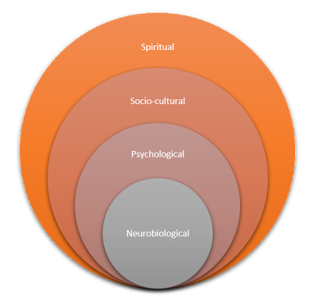
The “Whole” Person
*

Slide 42
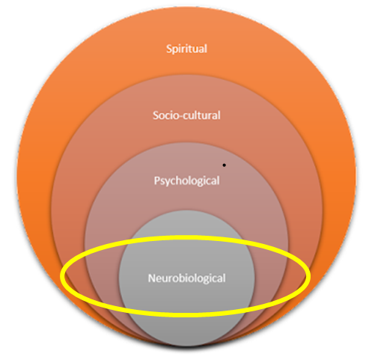
Neurobiological
Genetics — inherited vulnerability
Neurological health — disease,
brain injury, early brain development
Neuroplasticity (Neurons/Neural Pathways)
Hormones, Nervous System, gut health
Physical health — illness, nutrition
*

Slide 43
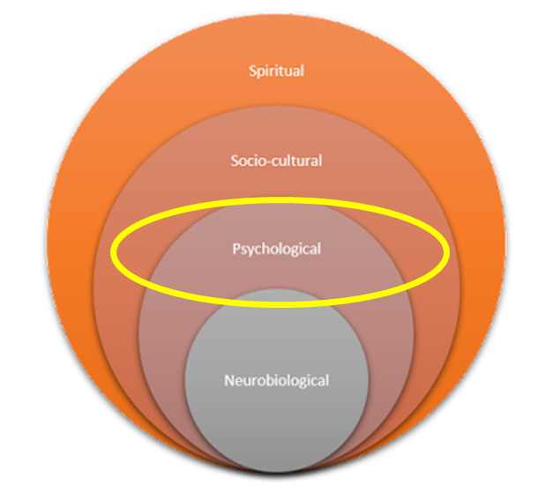
Psychological
Temperament (Personality, Optimistic, Pessimistic, etc)
Cognition (Critical thinking, attitude, memory)
Understand/Handle Emotions
How we handle stress - Coping skills
Impulse/self control
Mental Health
*

Slide 44
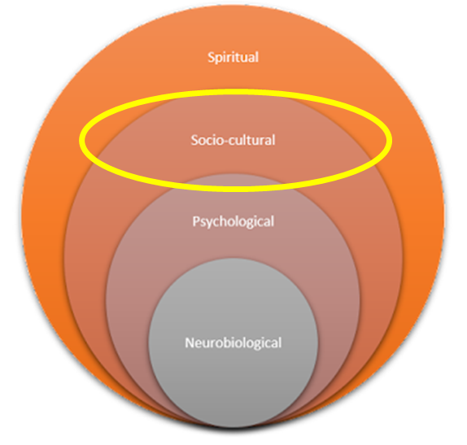
Socio-cultural
Family & Relationships
Church & Community
Work, School & Finances
Culture & Social Expectations
Life Experiences & Environment
*

Slide 45
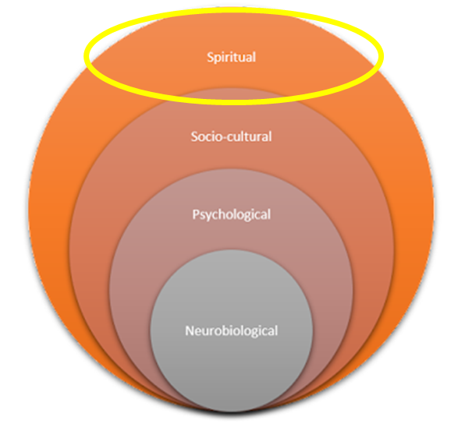

Spiritual
Biblical Worldview
Understanding of God
Conversion Experience
State of mind/heart (focus)
Spiritual Maturity
Role of Holy Spirit in our life
Faith
*

Slide 46
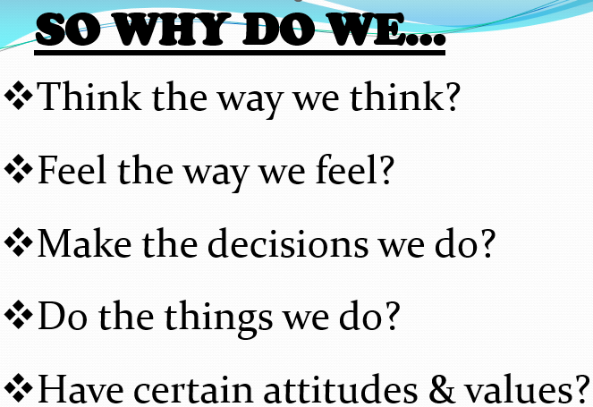
*

Slide 47

Common Treatments for mental illness
* Counseling
* Medication
* Lifestyle
*

Slide 48
Common Treatments for mental illness
* Counseling
      Talk with psychiatrist, psychologist or mental health provider
      Learn about your condition, get help to take control of your life and learn healthy coping skills
      Advantages: Training/experience
      Cautions: Worldview, limited
*

Slide 49
Common Treatments for mental illness
* Counseling
      Spiritual Counseling: Talk/pray with a minister, counselor, fellow Christian
      Provides empathy, accountability
      Advantages: encourage relationship with God, biblical help, same worldview
      Cautions: Lack of experience/training, in some cases dangerous (ex. Pray for a miracle to fix a broken arm/depression)
*

Slide 50
Common Treatments for mental illness
* Medication
      Critical for some illnesses
      For some, short term, symptoms disappear
      Others, long term (ie diabetes, schizophrenia)
      Concerns:
          “It will change me”
          “I am afraid of the side affects”
          “It did not work for so-and-so”
          “I will become addicted”
*

Slide 51
Common Treatments for mental illness
* Counseling
* Medication
* Lifestyle
*

Slide 52
Daily Things to AVOID for strong spiritual/mental health
Not being productive
Keep checking your phone mindlessly
“Brain Candy” (Dopamine saturation=depressed mood)
  Movies
  Video Games
  Social Media
  Unhealthy Snacking
Social Media
  FOMO (Fear of missing out)
  Comparing yourself to others
  (FACEBOOK/INSTAGRAM- in the news)
News Overload
*

Slide 53
Daily Things to AVOID for strong spiritual/mental health
6. “Doomscrolling”
7. Not getting outside
8. Isolating
9. Small talk/complaining vs constructive conversations
10. Screen time before bed
11. Not getting enough sleep
12. Trying to be perfect
13. Scheduling too much
14. Overthinking: mind never shuts off
15. Ruminating on negative thoughts
*

Slide 54
Practical Habits for Strong Spiritual & Mental Health
"Finally, brethren, whatsoever things are true, whatsoever things are honest, whatsoever things are just, whatsoever things are pure, whatsoever things are lovely, whatsoever things are of good report; if there be any virtue, and if there be any praise, think on these things.“ (Philippians 4:8)
*

Slide 55
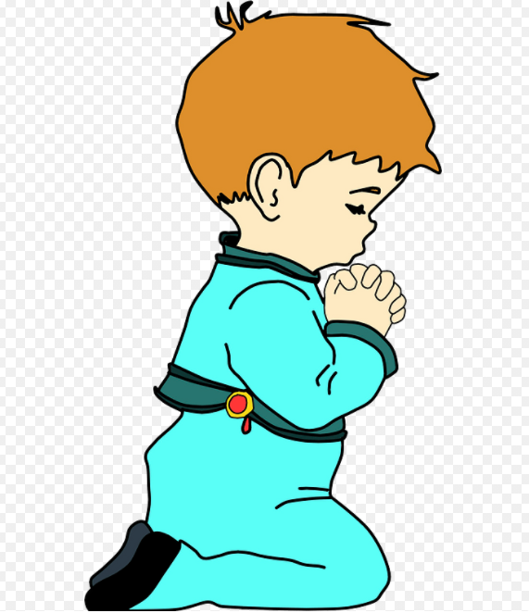
1. Prayer Time
“Cast your cares upon Him for He careth for you”
*

Slide 56

2. Devotional Time
“Cast your cares upon Him for He careth for you”
*

Slide 57

3. Focus on Fruit of the Spirit
“Cast your cares upon Him for He careth for you”
*

Slide 58

4. Reach out, don’t suffer in silence
“Cast your cares upon Him for He careth for you”
*

Slide 59

5. Get adequate sleep
“Cast your cares upon Him for He careth for you”
*

Slide 60
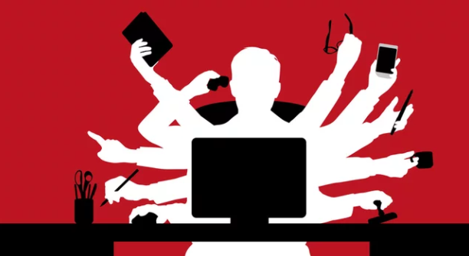
6. Learn to say “NO”
“Cast your cares upon Him for He careth for you”
*

Slide 61

7. Focus on what you can control
“Cast your cares upon Him for He careth for you”
*

Slide 62

8. Have Realistic Expectations
“Cast your cares upon Him for He careth for you”
*

Slide 63

9. Wholesome Hobbies
“Cast your cares upon Him for He careth for you”
*

Slide 64

10. Setting boundaries
“Cast your cares upon Him for He careth for you”
*

Slide 65

11. Be with those who encourage
“Cast your cares upon Him for He careth for you”
*

Slide 66

12. Avoid excessive “work”
“Cast your cares upon Him for He careth for you”
*

Slide 67

13. Exercise
“Cast your cares upon Him for He careth for you”
*

Slide 68
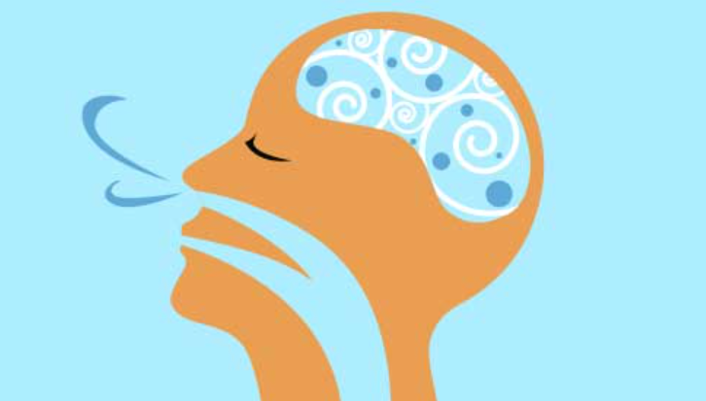
14. Breath!
“Cast your cares upon Him for He careth for you”
*

Slide 69
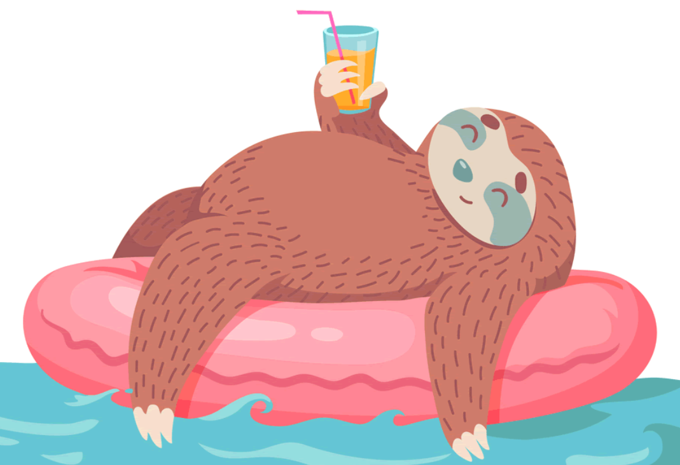
15. Be Productive
“Cast your cares upon Him for He careth for you”
*

Slide 70

16. Serve others
“Cast your cares upon Him for He careth for you”
*

Slide 71

17. Be Patient (self/others)
“Cast your cares upon Him for He careth for you”
*

Slide 72

18. Good eating habits
“Cast your cares upon Him for He careth for you”
*

Slide 73

19. Get outside
“Cast your cares upon Him for He careth for you”
*

Slide 74

20. Declutter
“Cast your cares upon Him for He careth for you”
*

Slide 75

21. Regular Schedule
“Cast your cares upon Him for He careth for you”
*

Slide 76

22. Self aware: be honest with thoughts/feelings
“Cast your cares upon Him for He careth for you”
*

Slide 77

23. Keep a Journal
“Cast your cares upon Him for He careth for you”
*

Slide 78

24. Put down cell phone
“Cast your cares upon Him for He careth for you”
*

Slide 79

25. Regular Church/Bible Class/Small Group
“Cast your cares upon Him for He careth for you”
*

Slide 80
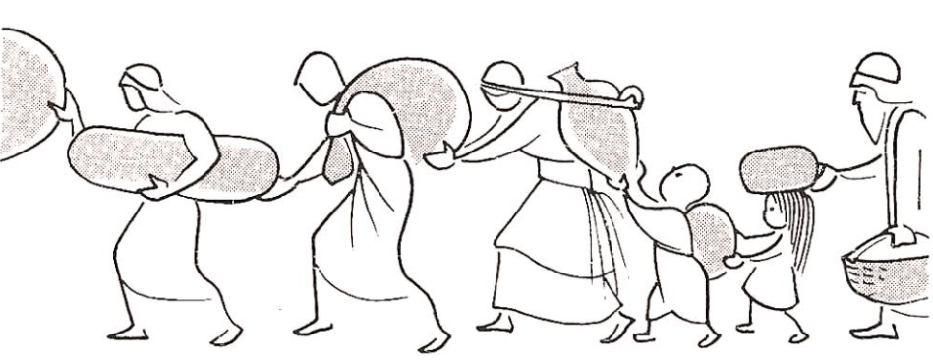
26. Be a burden bearer
“Cast your cares upon Him for He careth for you”
*

Slide 81
Should I be concerned about myself?
  Get educated
  Experiencing strong emotions does NOT mean I have a mental illness
  Symptoms are generally prolonged and interfere with normal living
  If you are not sure, talk to someone, don’t suffer needlessly
  If you are not getting answers that address your concerns, don’t stop, keep looking
*

Slide 82
How can I help?
  • Listen without judging or trying to fix everything
  • Pray with them and remind them of hope in Christ
  • Encourage appropriate professional & spiritual help
  • Stay connected — don’t let them suffer in isolation
  • Learn the facts & avoid harmful assumptions/labels
  • Offer practical help, patience, and ongoing support
*

Slide 83
God can use you to be a great help to those in need!!
Bear ye one another's burdens,
and so fulfil the law of Christ.
(Galatians 6:2)
*

Slide 84
PRESENTATION
Understanding
Mental Health &
Mental Illness
Apostolic Christian Church (Nazarean) of West Akron
SPEAKERS
Erik Taba Ed Jahn
226-260-2557 519-818-4137
Erik.taba@gmail.com ed@jahneng.com

